Slide 1
Framework and Data Model for OTN Network Slicing
draft-ietf-ccamp-yang-otn-slicing-03
Co-authors:
Aihua Guo (Futurewei)
Sergio Belotti (Nokia)
Reza Rokui (Ciena)
Luis M. Contreras (Telefonica)
Yunbin Xu (CAICT)
Yang Zhao (China Mobile)
Xufeng Liu (IBM Corporation)
Contributors:
Haomian Zheng (Huawei)
Italo Busi (Huawei)
Victor Lopez(Nokia)
Dieter Beller (Nokia)
Oscar Gonzales (Telefonica)
Henry Yu (Huawei)
Jiang Sun (China Mobile)

Slide 2
Updates Since IETF 114
Text Updates
Clarified the use of NRP in that multiple OTN slices may be mapped to the same NRP, and resources within the NRP are shared across those slices.
Added description for the technology-specific model for OTN-SC NBI
YANG Model Updates for OTN-SC NBI
Added common SLO/SLE augments in ietf-transport-network-slice; aligned the augments with Network Slice NBI YANG
Introduced 1st revision of ietf-otn-slice.yang with OTN technology-specific SLO/SLE augments
Resolving open issues
ietf-otn-slice
augments
This draft
ietf-transport-network-slice
augments
draft-ietf-teas-network-slice-nbi
ietf-network-slice-service
NBI model

Slide 3
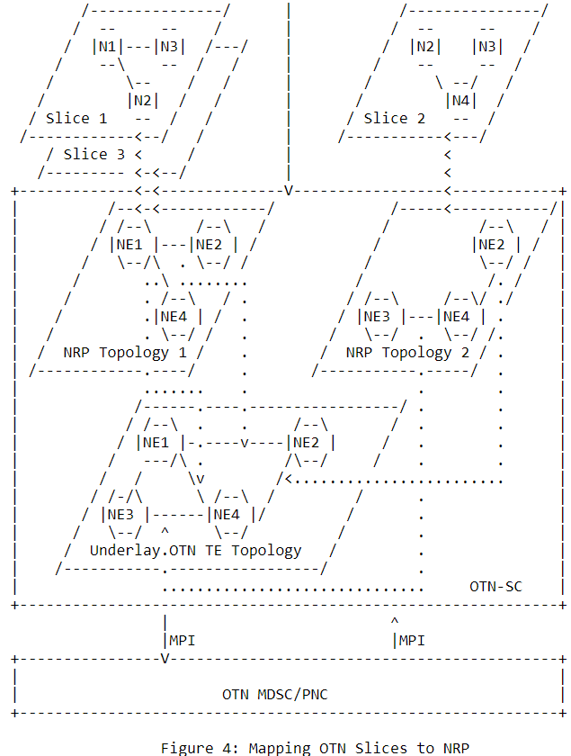
Update: Use of NRP for OTN Slicing
Multiple OTN slices may be mapped to the same NRP, and resources within the NRP are shared across those slices.
Use of NRP is not mandatory for OTN slicing
NRP represents logical resource reservation to given slices.
For OTN NRP does not require the programming of data plane

Slide 4
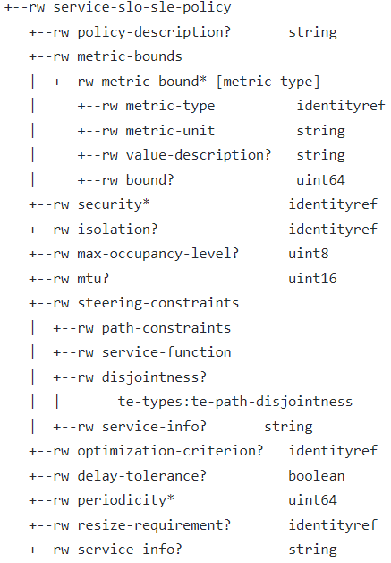
Model Updates for ietf-transport-network-slice
Added SLO/SLE augments for connections and topology
Applies to customized SLO/SLE policy for top-level objects like network slice, connection-group and topology, as well as sub-level objects, such as connectivity constructs, nodes, links, LTPs etc.
Common attributes for transport network slices that may be considered also for IETF network slice

Slide 5
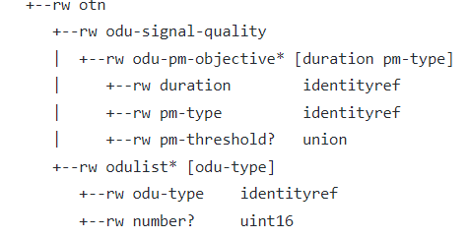
Model Updates for ietf-otn-slice
Augments ietf-transport-network-slice with additional SLO/SLE for OTN
ODU signal quality
Slice bandwidth objective in terms of number and type of ODU containers

Slide 6
Open Issue: defining technology-specific attributes
ietf-network-slice-nbi defines NS SLO/SLE attributes as a flat, opaque list
See https://github.com/lana-wu/ietf-ns-nbi/issues/23
May cause interoperability issues and requires additional implementation agreement for full interoperability
Cannot benefit from explicit YANG validation
Cannot be used to characterize complex attribute structures (e.g. ODU container)
ietf-transport-network-slice and ietf-otn-slice choose to instead explicitly define the attributes
Is there guideline on defining / using opaque attributes in YANG?

Slide 7
Open Issue: Network Slice with Topology
ietf-transport-network-slice defines a top-level topology to support resource-based slicing
Customer can define a slice with customized topology
Connectivity constructs can have an underlay path from within the customized topology
ietf-network-slice-nbi also intends to add reference to a customized underlay topology reference for network slices
TE topology based, exposed by the NSC
Is topology a customer’s intent, or a provider’s constraint?
Is TE topology the right model for network slicing NBI?
Underlying network may or may not be TE enabled
TE topology not an intent-oriented model
The TE topology model can be used as a model at the MPI for realization of network slices
Shall we merge ietf-transport-network-slice with ietf-network-slice-nbi?

Slide 8
Next Steps
Address open issues
Continue working with draft-ietf-teas-ietf-network-slice-nbi-yang-02 to align the two models
Define OTN technology-specific model based on ietf-transport-network-slice (which augments ietf-network-slice-service)
Technology-specific SLO/SLE for OTN
Multi technology links (non-OTN access links and OTN links)
Add a few examples for various types of OTN slices which combines the use of network-slice-nbi and otn-slice
* GitHub Repo
https://github.com/ietf-ccamp-wg/ietf-ccamp-yang-otn-slicing
* CCAMP Weekly Call: Thu 10-11am EST
https://mailarchive.ietf.org/arch/msg/ccamp/Dr3HWPlmP9LyA6NmabWJvx7hWIc/

Slide 9
Thank You!

